Slide 1
Azure Storage
Damir Dobric
daenet CEO, Lead Architect
Microsoft Regional Director
Azure Most Valuable Professional
https://damirdobric.me

Slide 2
Azure Storage
Storage Docs
Storage Account Concepts
Create Account: https://docs.microsoft.com/en-us/azure/storage/common/storage-account-create?tabs=azure-portal

Slide 3
Table Storage

Slide 4
Table Storage
Storage Account
CosmosDB Table API
Same samples work for both https://docs.microsoft.com/en-us/azure/storage/
git config --global http.proxy http://proxy.host.com:8080

Slide 5
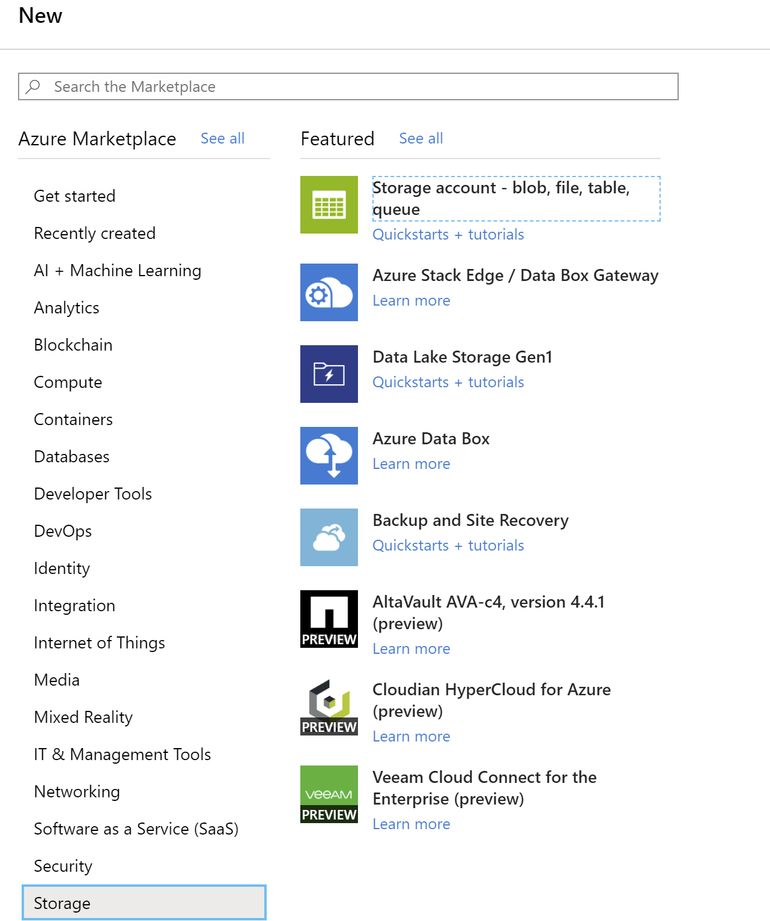
Create the Storage Account

Slide 6
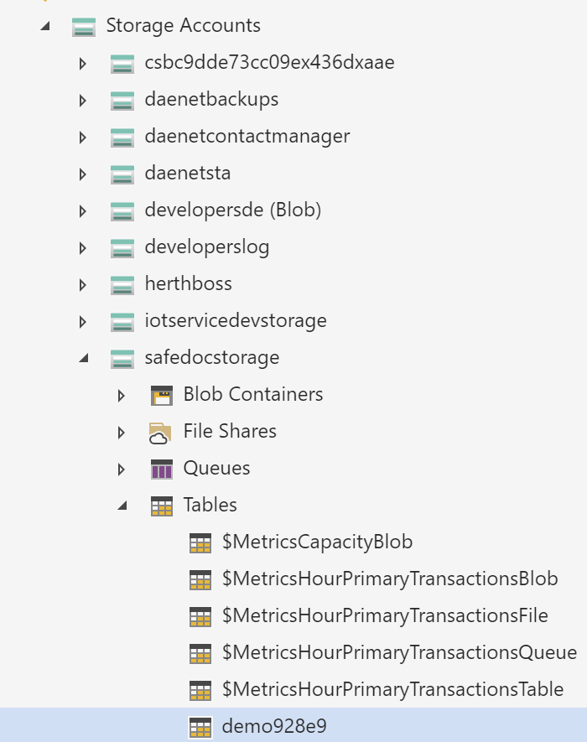
Microsoft Azure Storage Explorer

Slide 7
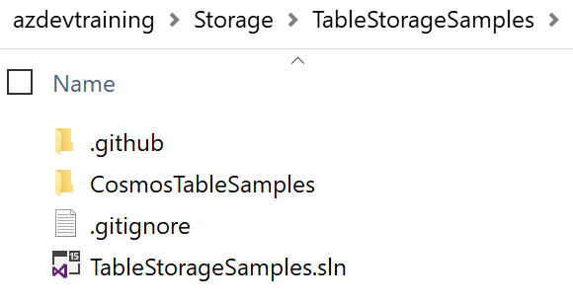
HoL - Table Storage
Step by step tutorial
https://docs.microsoft.com/en-us/azure/cosmos-db/tutorial-develop-table-dotnet#create-a-net-console-project
Complete example
Clone this repo:
https://github.com/Azure-Samples/azure-cosmos-table-dotnet-core-getting-started.git
Use TableStorageSamples

Slide 8
Blob Storage

Slide 9
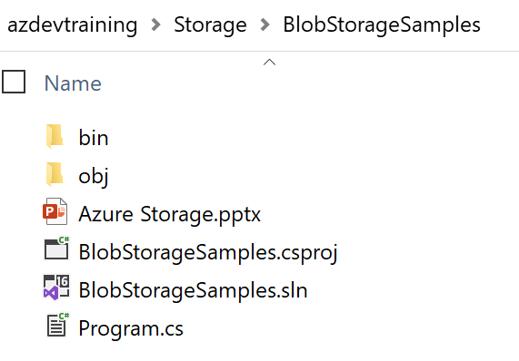
Blob Storage HoL
Blob Storage Intro
https://docs.microsoft.com/en-us/azure/storage/blobs/storage-blobs-overview
Use BlobStorage Sample
Samples in git repo
https://github.com/Azure-Samples/storage-blob-dotnet-getting-started

Slide 10
Thank You

Slide 11
Queue Storage

Slide 12
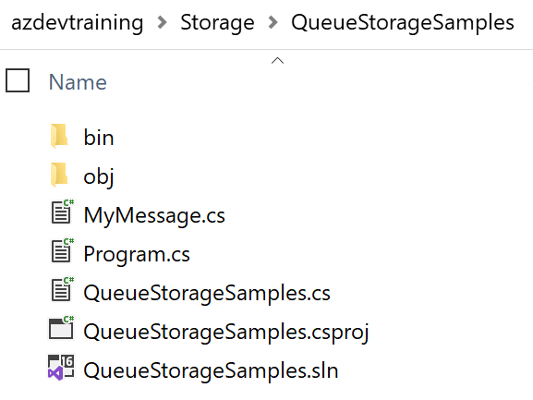
Blob Storage HoL
Use QueueStorageSample

